Slide 1

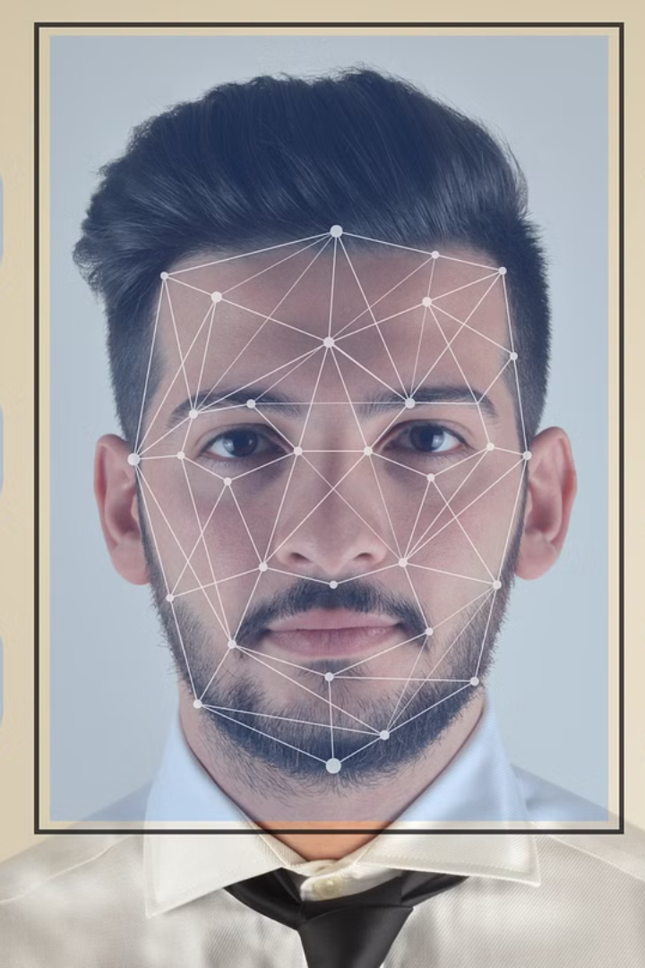


Introduction to Face Detection
Face detection is a key component of facial recognition technology, used for identifying and verifying people in images or videos.
by ARUN KUMAR

Slide 2



How Face Detection Works
Data Collection
Feature Extraction
Matching & Verification
Gathering images or video frames with faces.
Identifying unique facial features.
Comparing and verifying against existing data.

Slide 3

Key Components of a Face Detection System
Camera or Sensor
Algorithms
Database
For capturing images or video frames.
Used to identify and verify facial features.
Storing and comparing facial data.

Slide 4
Applications of Face Detection Technology
Security & Surveillance
Human-Computer Interaction
Identifying individuals for access control.
Enabling face unlocking in devices.
Monitoring public areas for security.
Gesture recognition and virtual try-ons.

Slide 5

Challenges and Limitations of Face Detection
1
Data Quality
2
Diversity
Noisy or low-resolution images.
Accurate detection across different ethnicities.
3
Privacy Concerns
Potential misuse and biometric data protection.

Slide 6
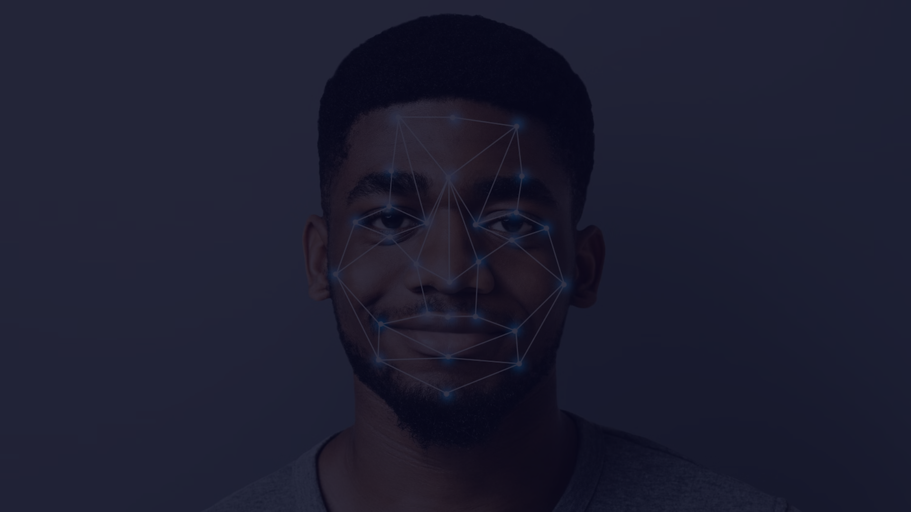
Advances in Face Detection Algorithms
1
Deep Learning
Enabling higher accuracy and faster processing.
2
3D Face Recognition
Enhanced recognition in different lighting conditions.
3
Emotion Recognition
Identifying facial expressions and emotions.

Slide 7



Ethical Considerations in Face Detection
Privacy
Fairness
Regulations
Respect user privacy in data collection.
Avoid biases in recognition across groups.
Adherence to legal and ethical standards.

Slide 8
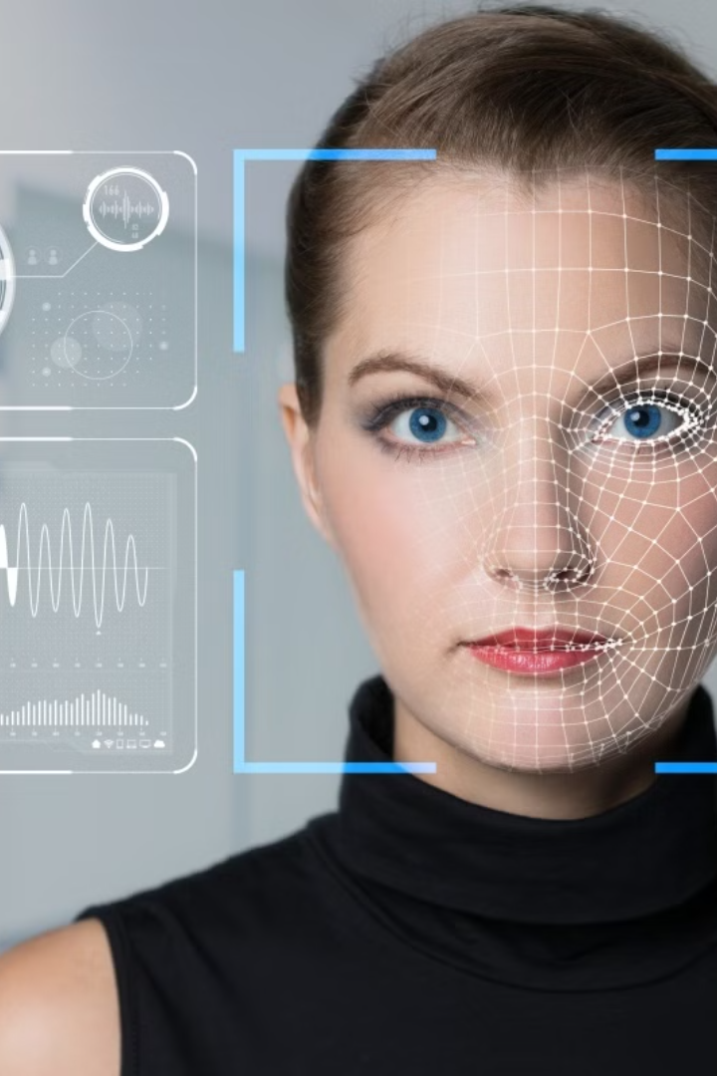
Conclusion and Future Prospects
Face detection technology has come a long way, and with continued advancements in AI and deep learning, it holds the potential for more accurate and ethical applications in the future.

